Slide 1
Reinforcement Learning for Signal Process
1/31/2024

Slide 2
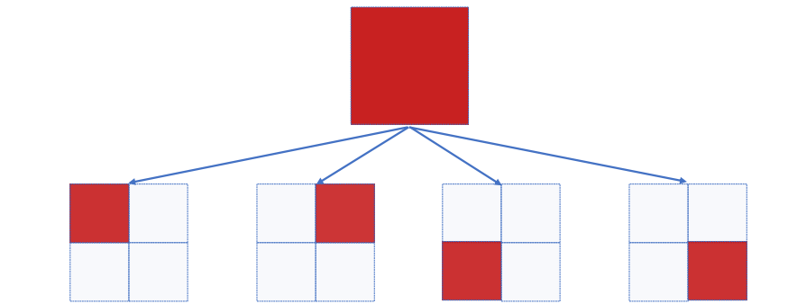
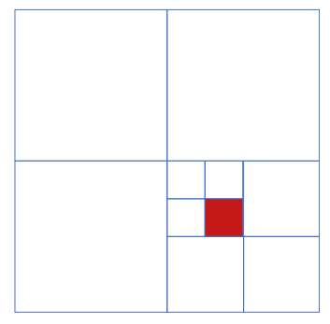
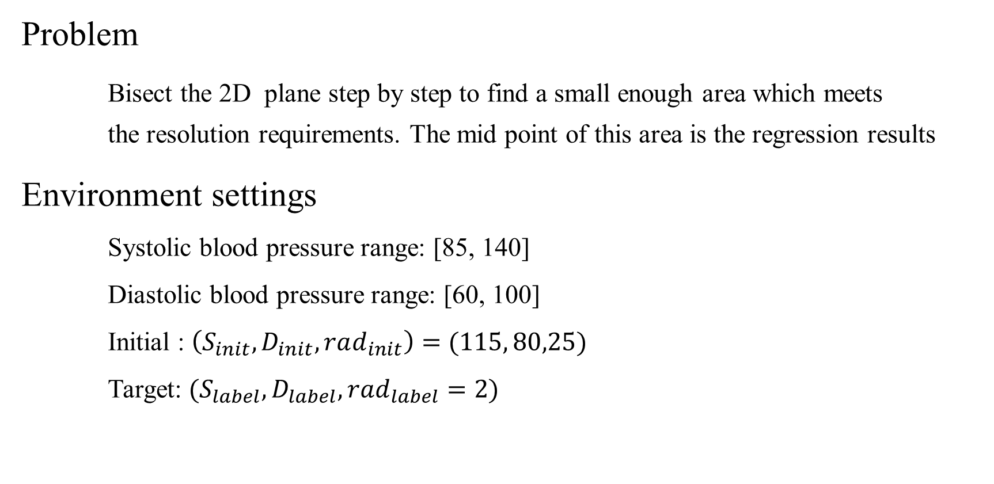
Problem
Bisect the 2D plane step by step to find a small enough area which meets the resolution requirements. The mid point of this area is the regression results
Environment settings
Systolic blood pressure range: [85, 140]
Diastolic blood pressure range: [60, 100]
Initial : $\left(S_{init},D_{init}, rad_{init}\right)=(115, 80,25)$
Target: $(S_{label}, D_{label}, rad_{label}=2)$

Slide 3
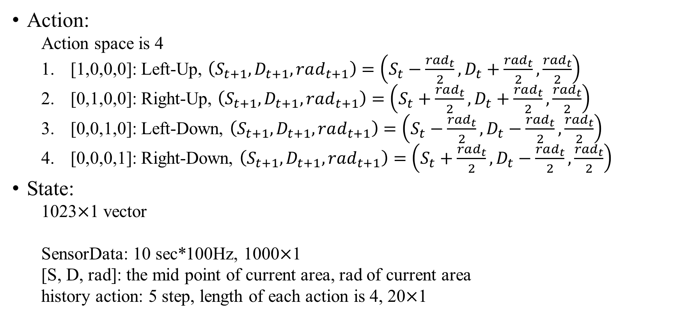
State, Action and Reward
Action:
Action space is 4
[1,0,0,0]: Left-Up, $\left(S_{t+1},D_{t+1}, rad_{t+1}\right)=\left(S_{t}−\frac{rad_{t}}{2}, D_{t}+\frac{rad_{t}}{2},\frac{rad_{t}}{2}\right)$
[0,1,0,0]: Right-Up, $\left(S_{t+1},D_{t+1}, rad_{t+1}\right)=\left(S_{t}+\frac{rad_{t}}{2}, D_{t}+\frac{rad_{t}}{2},\frac{rad_{t}}{2}\right)$
[0,0,1,0]: Left-Down, $\left(S_{t+1},D_{t+1}, rad_{t+1}\right)=\left(S_{t}−\frac{rad_{t}}{2}, D_{t}−\frac{rad_{t}}{2},\frac{rad_{t}}{2}\right)$
[0,0,0,1]: Right-Down, $\left(S_{t+1},D_{t+1}, rad_{t+1}\right)=\left(S_{t}+\frac{rad_{t}}{2}, D_{t}−\frac{rad_{t}}{2},\frac{rad_{t}}{2}\right)$
State:
1023$×$1 vector
SensorData: 10 sec*100Hz, 1000$×$1
[S, D, rad]: the mid point of current area, rad of current area
history action: 5 step, length of each action is 4, 20$×$1

Slide 4
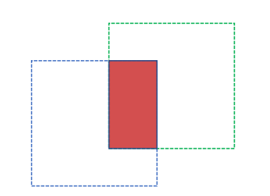
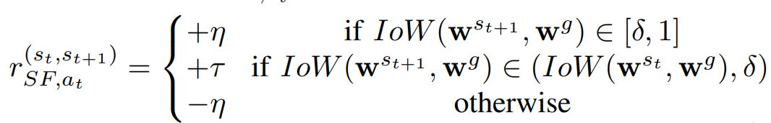

State, Action and Reward
Reward:
In each state, area is a square with (S, D) as the center and rad as the radius
Define $η=5, τ=1, δ=0.5$
$$IoW\left(w, w^{g}\right)=\frac{area\left(w\right)∩area\left(w^{g}\right)}{area(w)}$$

Slide 5
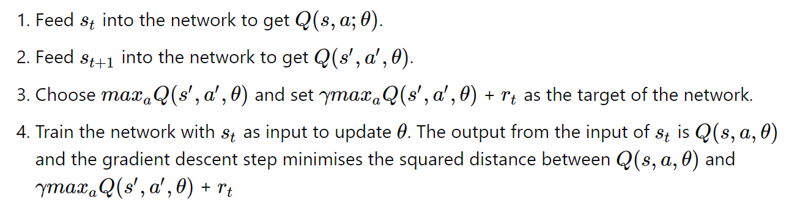
Deep Q Learning
Deep neural network
Estimate Q value
Layer | Input | Output | Activation Function
Linear1 | 1023 (state size) | 512 | ReLU
Linear2 | 512 | 256 | ReLU
Linear3 | 256 | 256 | ReLU
Linear4 | 256 | 128 | ReLU
Linear5 | 128 | 4 (action size) | /

Slide 6
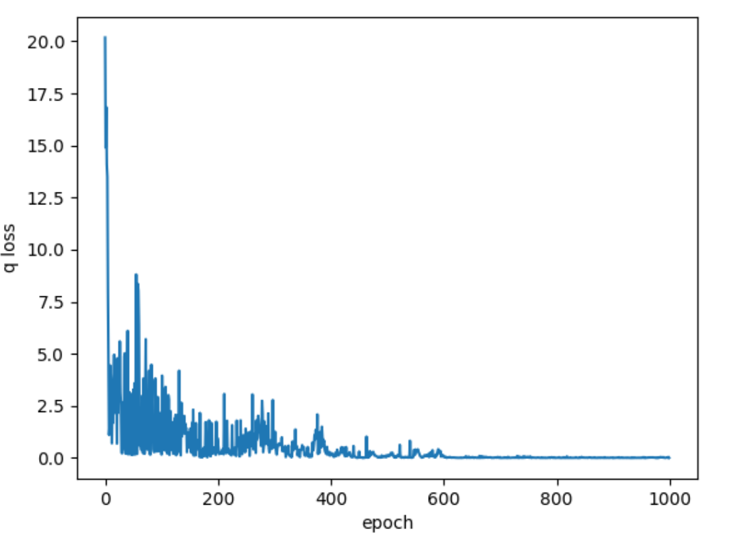
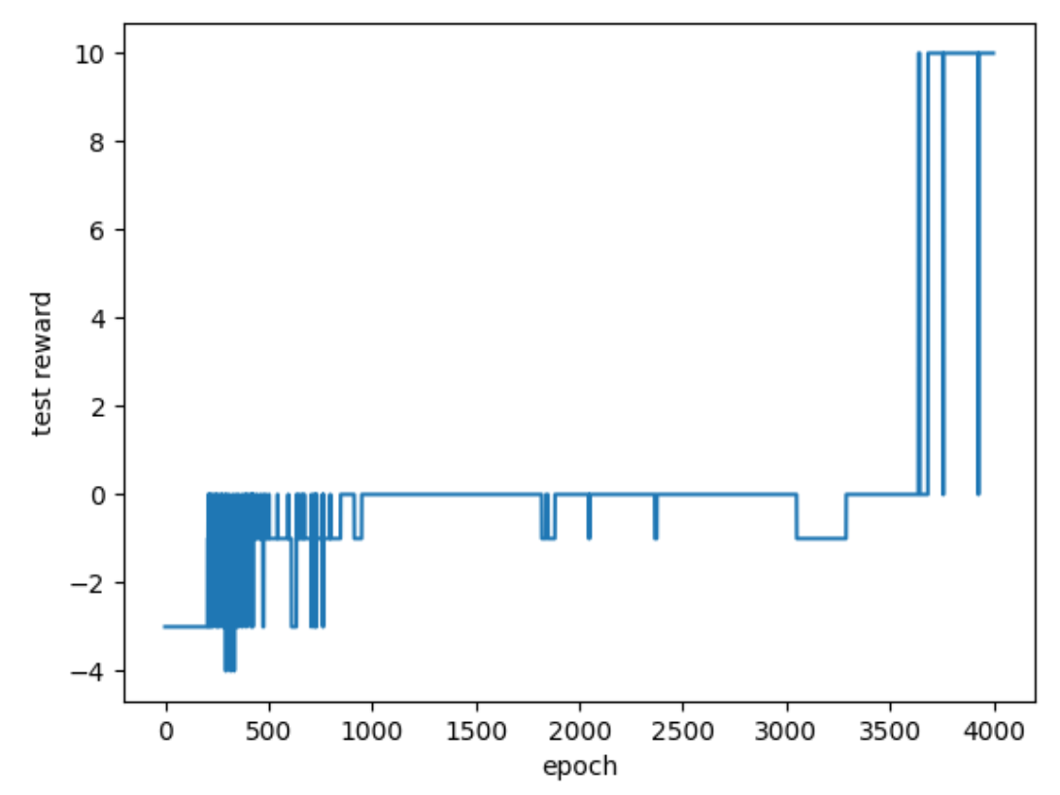
Training details
Dataset size = 1

Slide 7
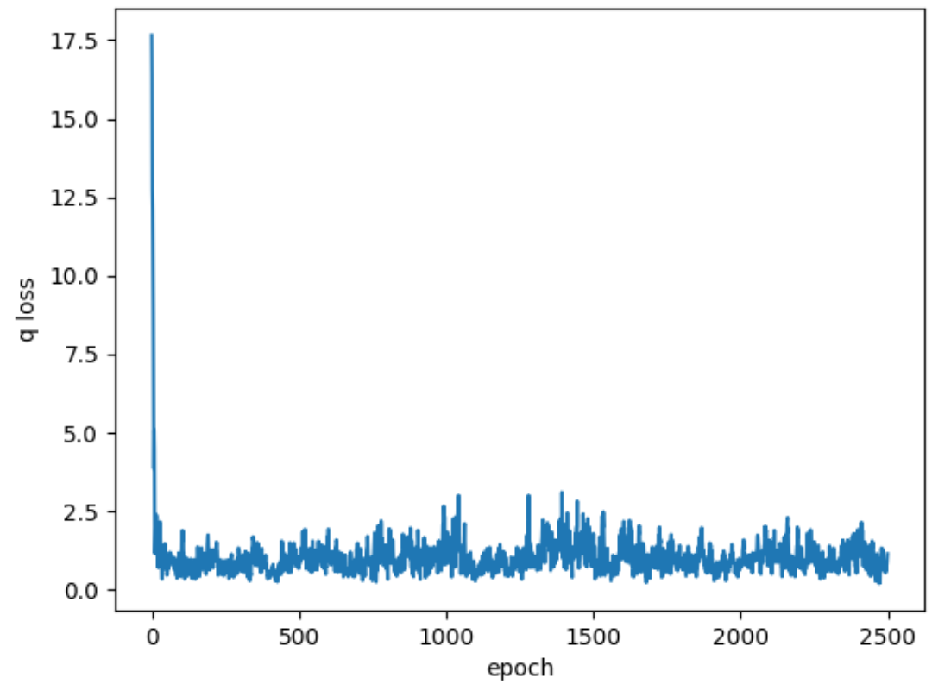
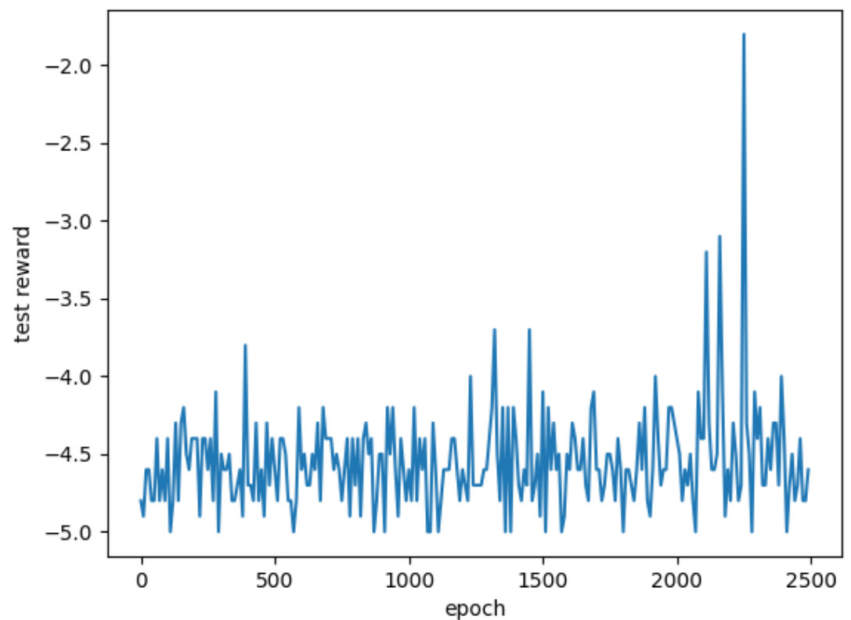
Training details
Dataset size = 10

Slide 8
THANKS

